Slide 1
CHAPTER 2 Basic concepts and definitions
Thermodynamics for BMEng
Prepared by: Mehiret W. (MSc.)
October2022

Slide 2
Recap Question
What is Thermodynamics?
How is it beneficial to your career?
What is the difference between classical and statistical thermodynamics?
Discuss the operation of power plant?
Discuss the difference between a refrigerator and heat pump?

Slide 3
Outlines
Closed, open and Isolated systems
Properties, phase, state, equilibrium, and process
Forms of energy
Dimensions and units
Zeroth law of thermodynamics

Slide 4
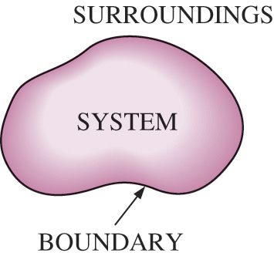
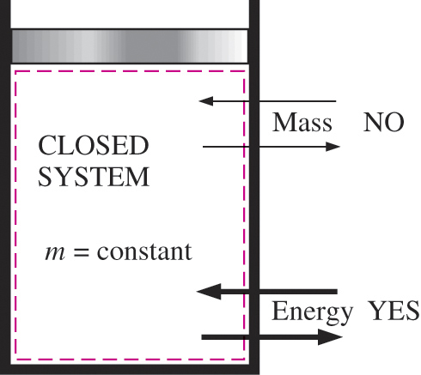
2.1 Closed, Open and Isolated Systems
System: A quantity of matter or a region in space chosen for study.
Surroundings: The mass or region outside the system
Boundary or surface: The real or imaginary surface that separates the system from its surroundings.
The boundary of a system can be fixed or movable.
Systems may be considered to be closed, open Or Isolated
Closed system (Control mass): A fixed amount of mass, and no mass can cross its boundary.

Slide 5
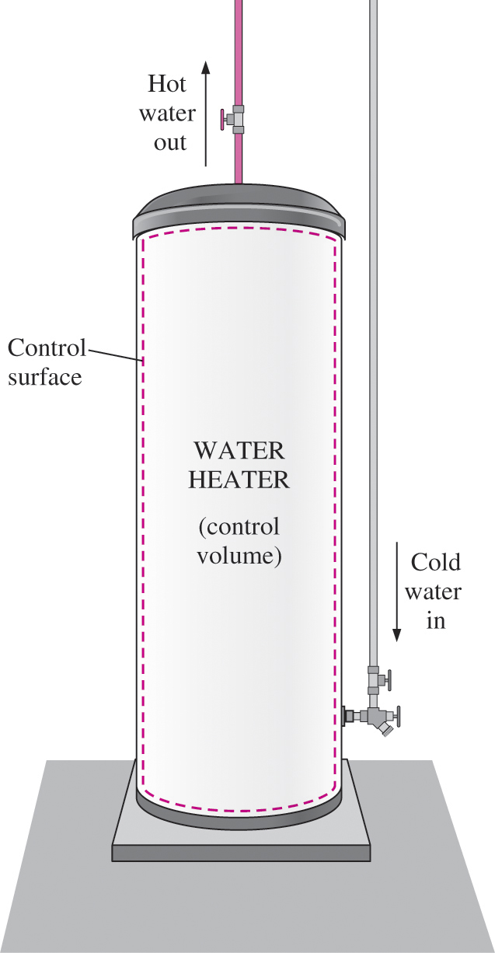
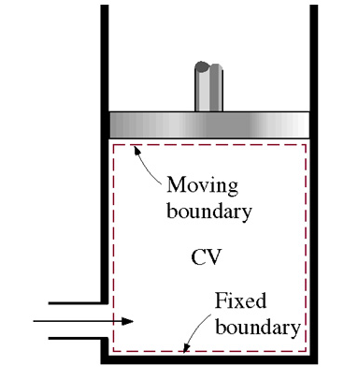
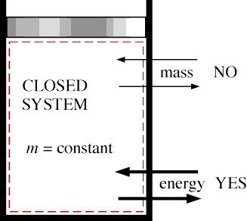
Cont’d
Open system (control volume): A properly selected region in space.
It usually encloses a device that involves mass flow such as a compressor, turbine, or nozzle.
Both mass and energy can cross the boundary of a control volume.
Isolated system: A system closed to mass, heat and work flows. It is not affected by the surroundings.
An open system (a control volume) with one inlet and one exit.

Slide 6
2.2 Properties, phase, state, Equilibrium, and process
Any measurable quantity that describes the condition of a system is called a property. E.g T, P, m, V, density
Properties are of two types;
Intensive properties are independent of the mass of the system. Examples: temperature, pressure, and density.
Extensive properties are those whose value depends on the size of the system. Examples: Total mass, total volume, and total momentum.
Extensive properties per unit mass are called specific properties. Examples include specific volume v = V/m and specific total energy e=E/m.

Slide 7
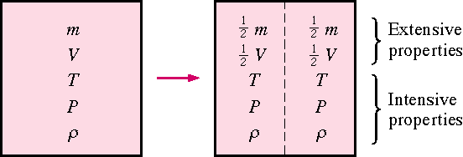
2.2 Properties, phase, state, Equilibrium, and process

Slide 8
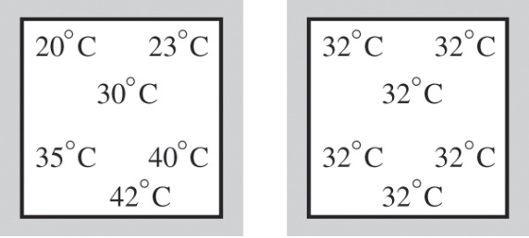
2.2 Properties, phase, state, Equilibrium, and process
Properties of a system are defined when the system is in equilibrium.
Equilibrium: No unbalance exist in the system, and values of properties (T, P etc.) remain the same when it is isolated from the surroundings.
Thermal equilibrium: temperature of system does not change when it is isolated from surrounding
Mechanical equilibrium: pressure of system does not change when it is isolated from surrounding
Chemical equilibrium: chemical composition does not change when it is isolated from surroundings

Slide 9
2.2 Properties, phase, state, Equilibrium, and process
State : Condition of a system in equilibrium at a given time t identified by properties (e.g. T, P, v).
at a given state each property has 1 value.
Thermodynamic properties: also termed state parameters or state variables are variables that quantify the state of a system.

Slide 10
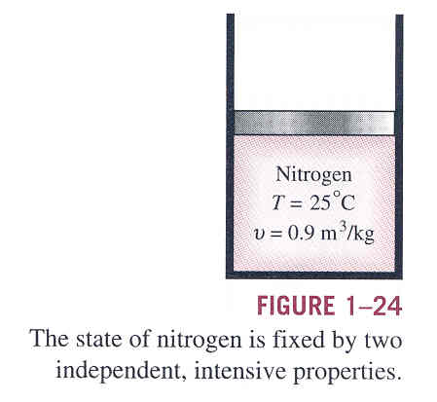
2.2 Properties, phase, state, Equilibrium, and process
The state of a simple compressible system can be uniquely described if two of its independent intensive variables are known. This is termed as the state postulate.
Simple compressible system: a system whereby energy transfer by work into & out of the system occurs by volume change only. ( does not involve any work done by electrical, magnetic, gravitational, motion, and surface tension effects)
Properties are independent when
one can vary while the other
remains constant.

Slide 11
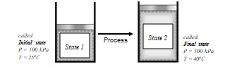
2.2 Properties, phase, state, Equilibrium, and process
Process : The transformation of a system from one state to another state through a succession of states.
Quasi-equilibrium process (ideal process): The system is very near to equilibrium in all successive states during the process.
Non-equilibrium process: The system is not in equilibrium during the process. States during the process are undefined. We can only define the initial and final states.

Slide 12
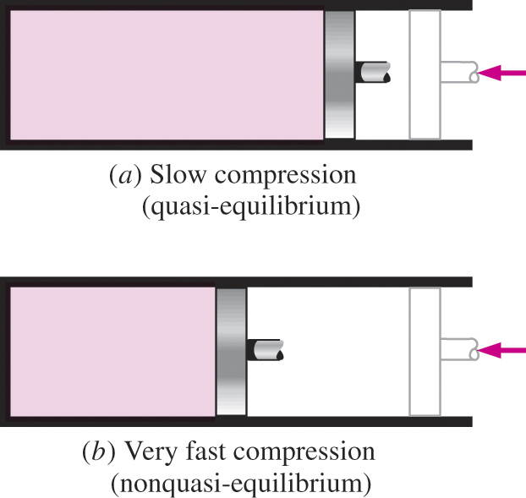
2.2 Properties, phase, state, Equilibrium, and process
Process : The transformation of a system from one state to another state through a succession of states.
Quasi-equilibrium process and Non-equilibrium process

Slide 13
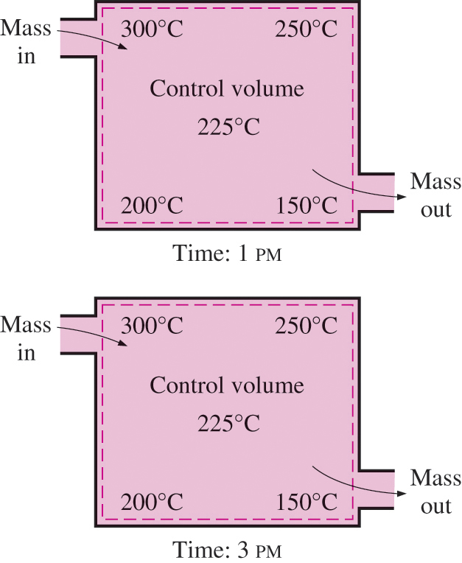
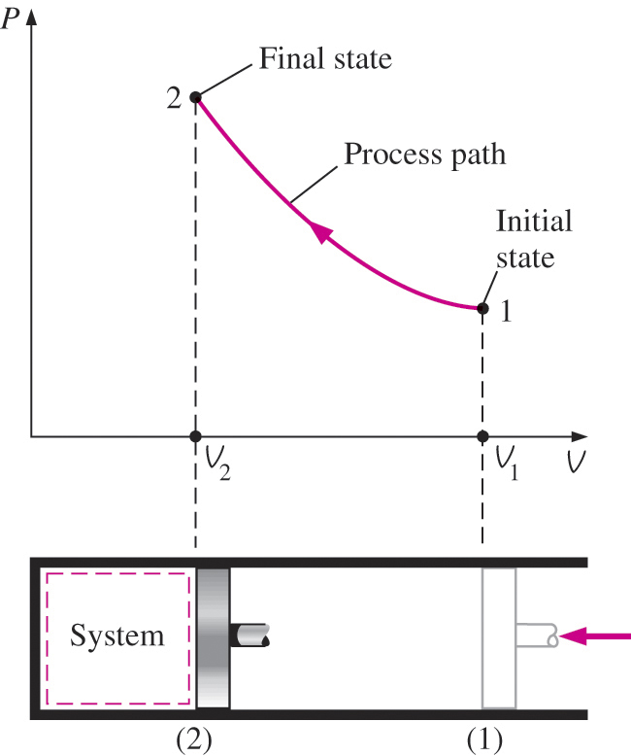
2.2 Properties, phase, state, Equilibrium, and process
Whether the process is quasi-equilbrium or non equilibrium, it could be steady or unsteady.
Steady process: if the conditions do not change with time at each location during the process. (defined for control volume)

Slide 14
2.3 DIMENSIONS AND UNITS
Any physical quantity can be characterized by dimensions.
The magnitudes assigned to the dimensions are called units.
Dimensions can be primary or secondary. Secondary dimensions are derived from primary.
Metric SI system: A simple and logical system based on a decimal relationship between the various units.
English system: It has no apparent systematic numerical base, and various units in this system are related to each other rather arbitrarily.

Slide 15
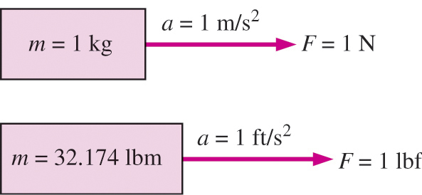

Some SI and English Units
Cont’d
English: lb for mass, ft for length and s for seconds
SI: kg for mass, m for length and s for seconds

Slide 16
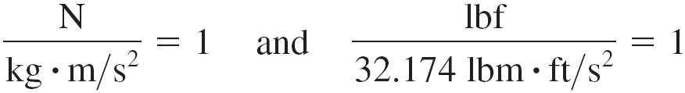
Unity Conversion Ratios
Dimensional homogeneity
All equations must be dimensionally homogeneous.
Are ratios with a value of 1 and can multiply terms in an equation to bring dimensional homogeneity.
Force units, for example, can be expressed as
They can also be expressed more conveniently as unity conversion ratios as:
Unity conversion ratios are identically equal to 1 and are unitless, and thus such ratios (or their inverses) can be inserted conveniently into any calculation to properly convert units.

Slide 17
Example 1. using unity conversion ratio prove that weight of 1lbm is equivalent to 1lbf on earth. (g=32.174ft/s2)
Cont’d

Slide 18

2.4 Forms of Energy
Energy contained in a system is also a property since it tells us the condition of the system.
Forms of energy can be grouped into microscopic and macroscopic.

Slide 19
2.4 Forms of Energy
Energy is contained in a system as internal, kinetic and potential energy

Slide 20
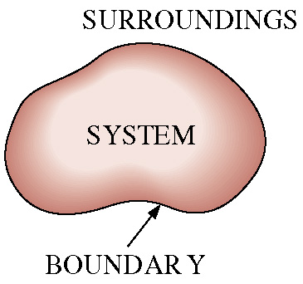
2.4 Forms of Energy
Energy is contained in a system (as U + KE + PE) and can be transferred at the system boundary (as Heat and/or Work)
Transfers (enters or leaves)
at the system boundary as
Heat or Work
Contained/Stored
In a system as
U + KE + PE

Slide 21
2.4 Forms of Energy
3 ways in which energy is stored as internal energy (U) ,microscopic form, in each phase of a substance.
Intermolecular potential energy: Because of forces between molecules.
Molecular kinetic energy: Because of translational motion of molecules
3. Intra molecular energy (within individual molecules) : Because of the molecular and atomic structure and related forces

